Slide 1


TEAM NO.12 Freshers bunch
THRISHA
RAKSHITA.M
HASINI.D
VARSHA GOWDA

Slide 2
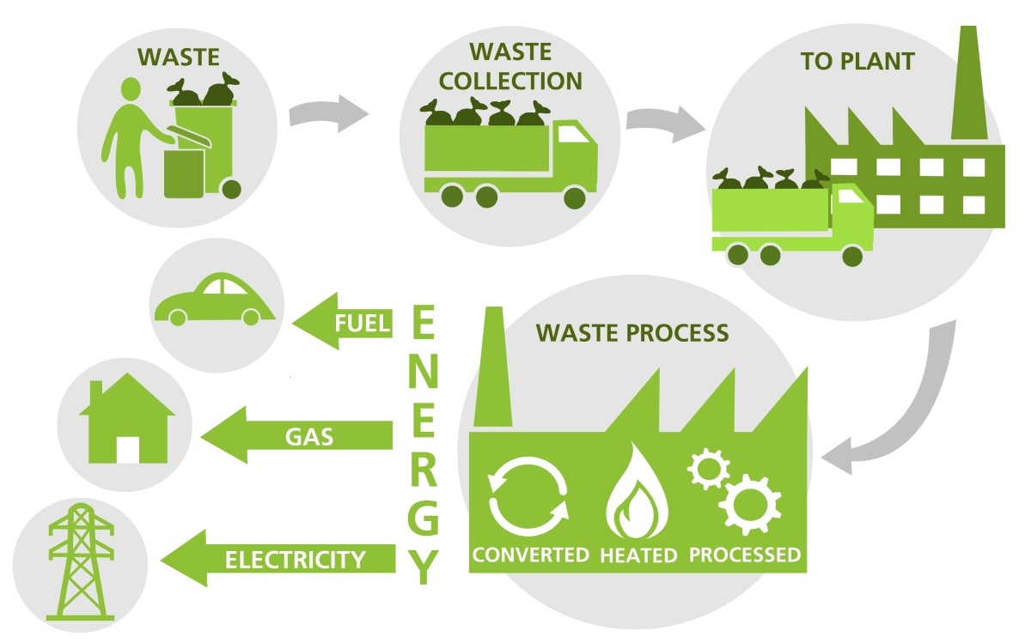
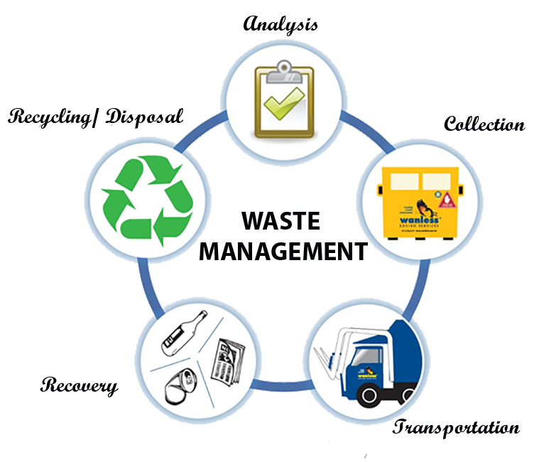
Category: Healthcare
PROBLEM STATEMENT:
24. To develop an ONLINE eco friendly mechanism to dispose of various types of waste material which can be converted into energy.

Slide 3
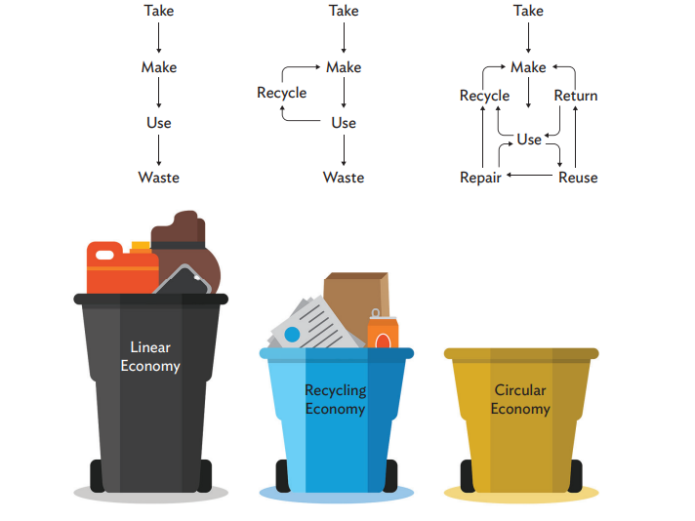

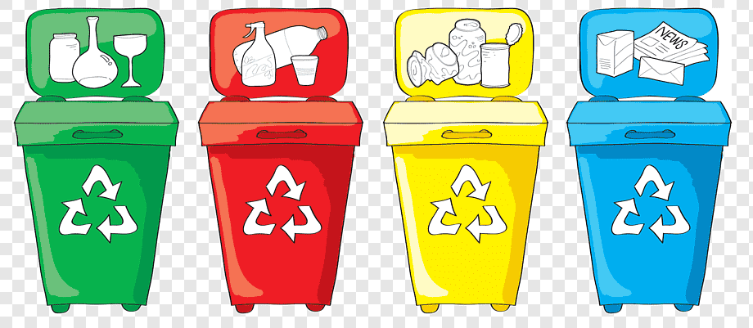
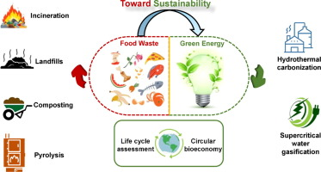
OBJECTIVES
ONLINE ECO FRIENDLY METHOD
SYSTEMATIC WASTE MANAGEMENT
SEGREGATION BEFORE COLLECTION
WASTE TO ENERGY
LITERATURE SURVEY
Google
Wikipedia
Youtube

Slide 4
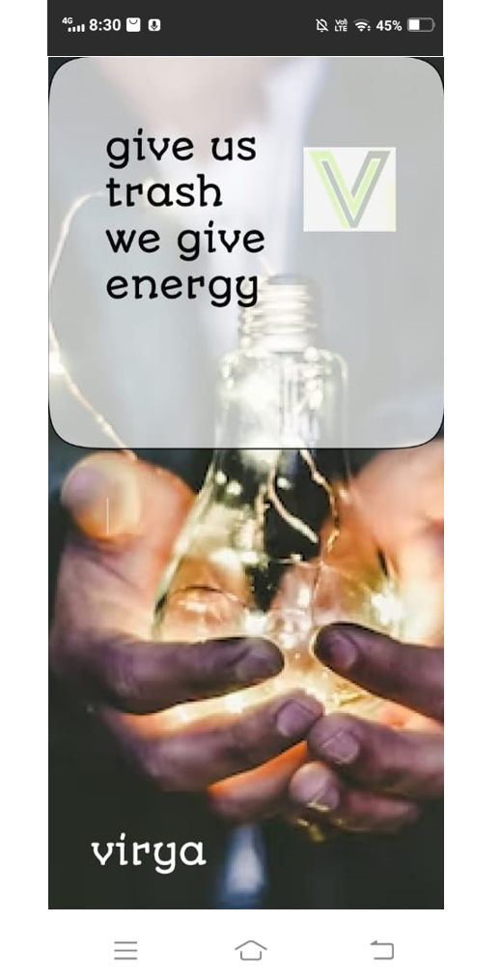
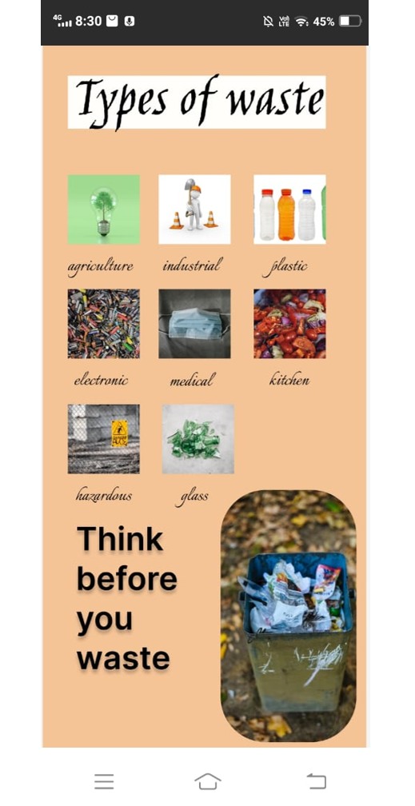
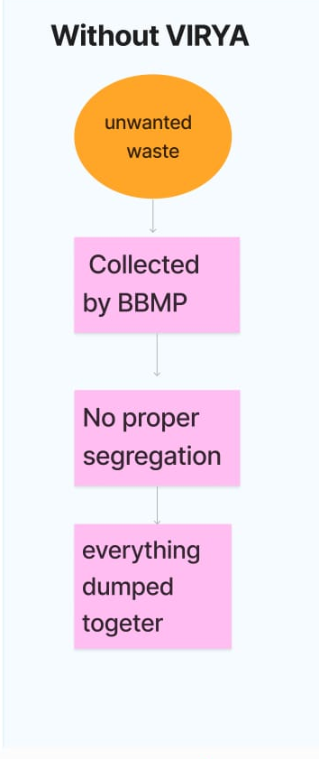
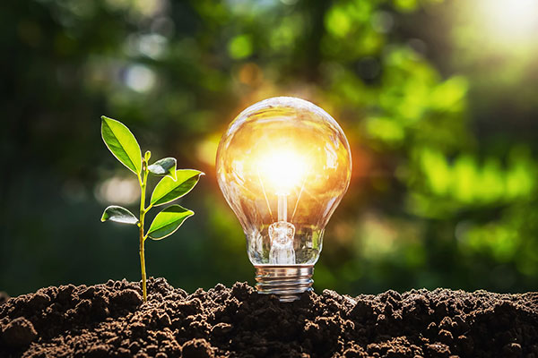
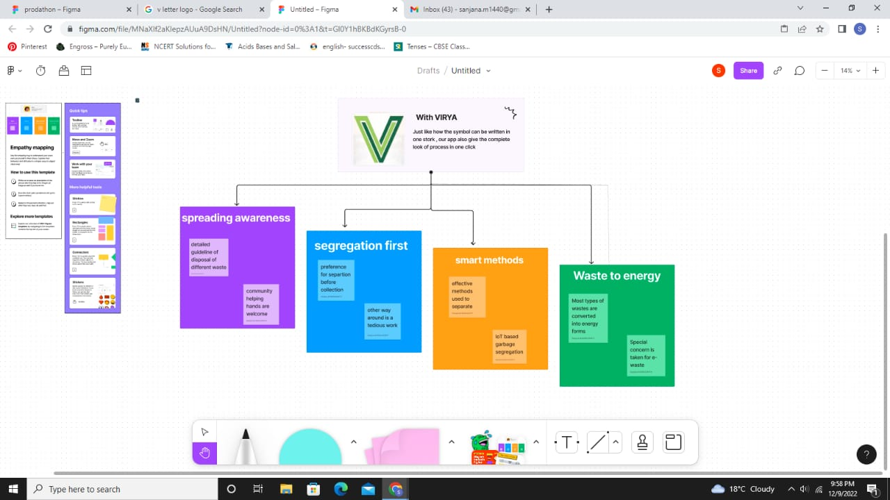
OUR WEBSITE:VIRYA GIVE US TRASH WE GIVE YOU ENERGY

Slide 5
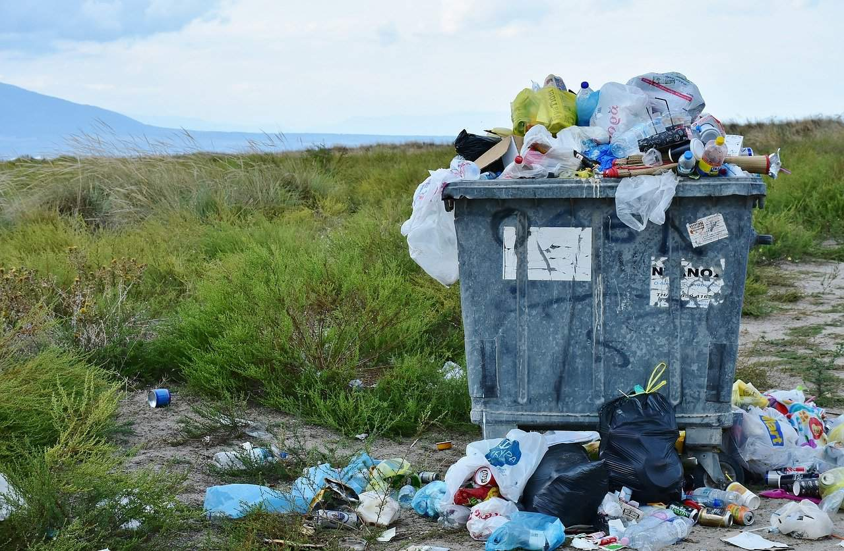
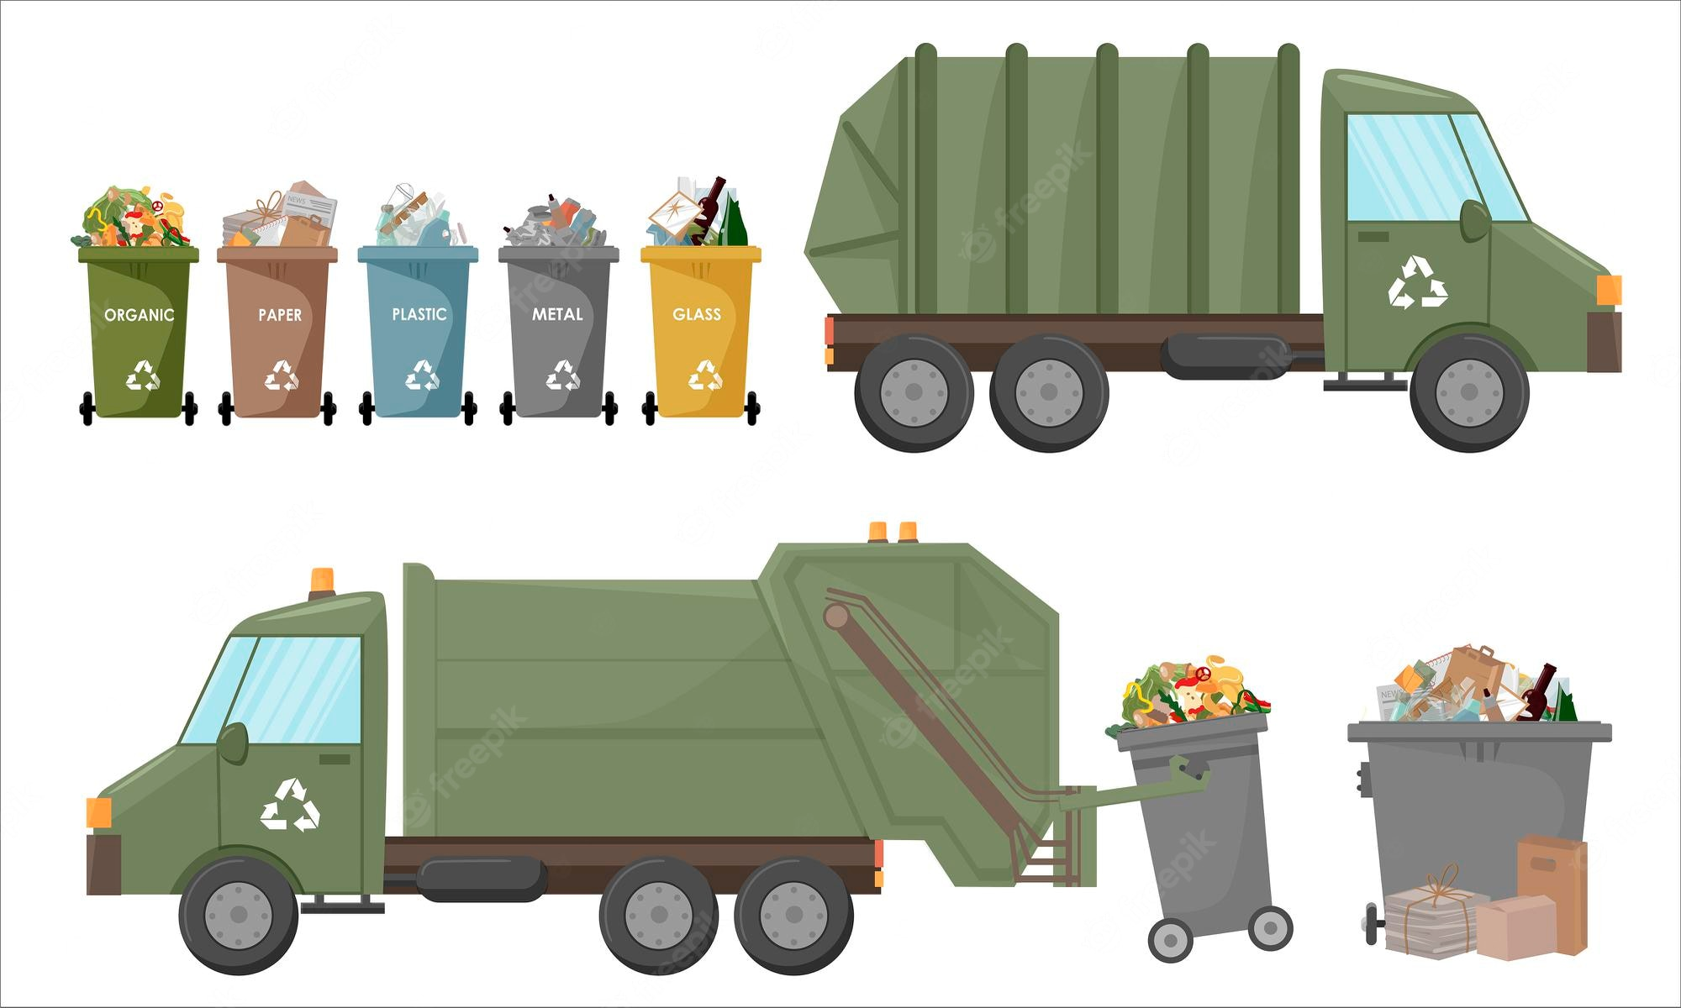
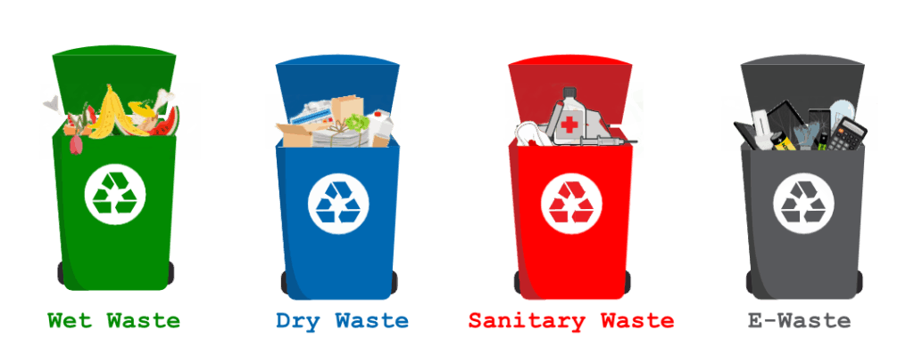
WASTE TO ENERGY
INCINERATION
The heat that is generated during the combustion process is utilized to turn water into steam that is inturn used to power turbine to generate electricity
Gasification
The process of converting waste material in presence of oxygen. Fuel can be created and electricity can be generated
pyrolisis
Process of converting waste material in absence of oxygen. Coal, cardboard paper, plastic, rubber like materials can be converted into to char or bio oil
FERMENTATION
The process that uses yeast and other micro organisms to produce ethanol is known as fermentation

Slide 6

Technical Specifications
HTML(Hypertext Markup Language)
Structure a web page and its content
CSS(Cascading Style Sheets)
Style and layout web pages, including colors, layout, and fonts
JavaScript
Dynamic and interactive web content like applications and browsers

Slide 7

SWOT Analysis
Due to its wide range it may be hard to implement
Strengths
It is a long term and time taking process
Many different methodologies available and is one of the first of its kind
Threats
Weaknesses
Opportunities
Availability of the technologies to implement this project

Slide 8
Virya
Market target segment
Competitive alternatives
USP(unique selling point)
Pursue scalable service through sustainable strategies
Engage different methodologies with web-enabled technologies
Engage top-line web services
As it is based in the public sector there are none

Slide 9

Summary
Its about lessening the strain on the environment through minimizing the need to fully dispose.
Recycling, composting, incineration, bioremediation, waste to energy and waste minimization.

Slide 10

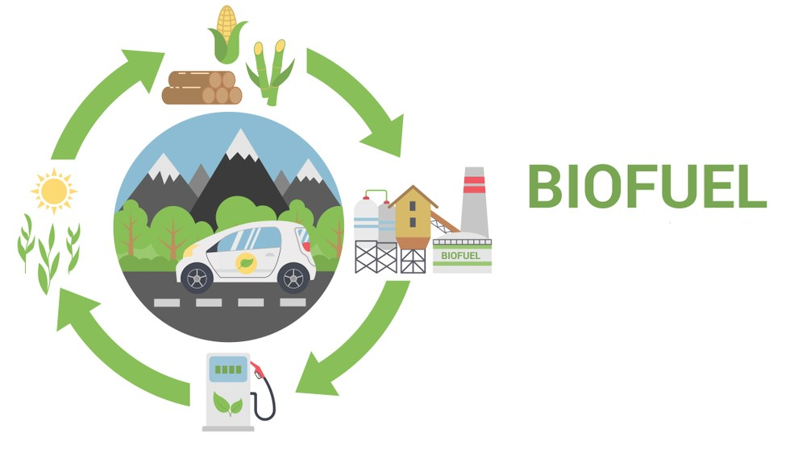

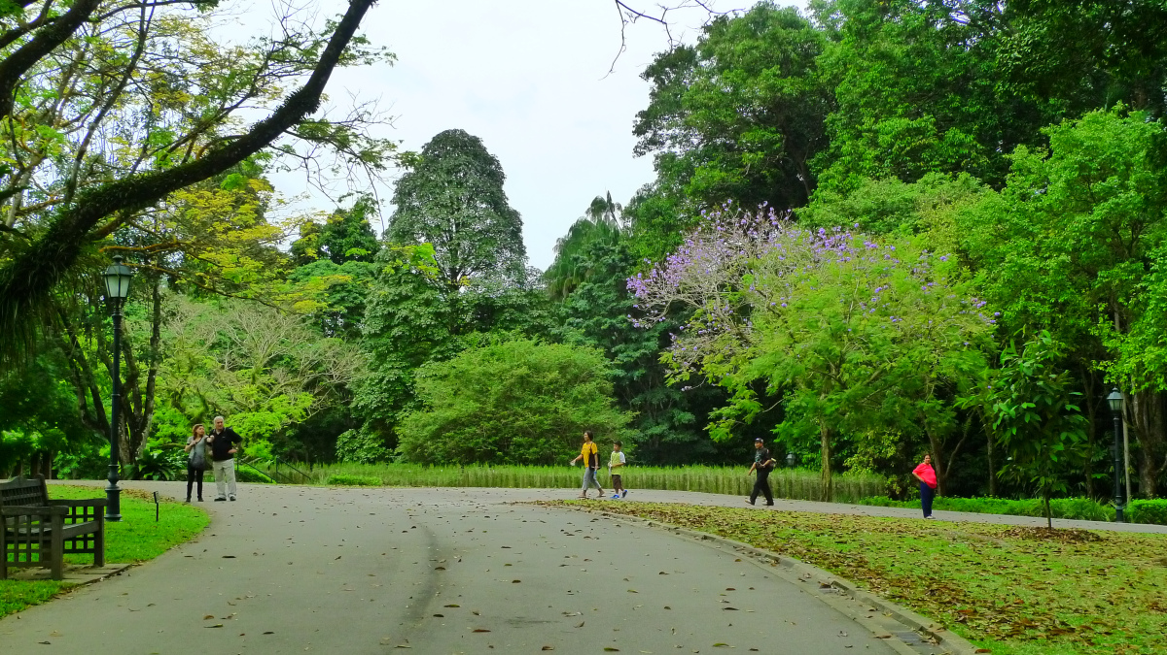
Conclusion
REDUCE LANDFILL WASTE
CREATES A SIGNIFICANT AMOUNT OF ENERGY
CLEAN ENVIRONMENT
REDUCE GREENHOUSE GASES
COMPLETELY SUSTAINABLE

Slide 11

THANK YOU

